Slide 1
Geoprocessing and Arcpy
Gregory Brunner

Slide 2
Geoprocessing

Slide 3
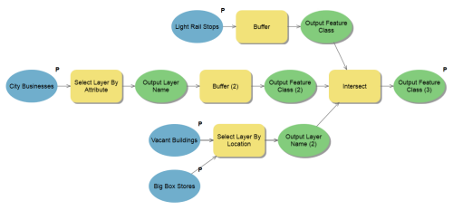
What is Geoprocessing
Spatial analysis
Data modeling
Task automation

Slide 4
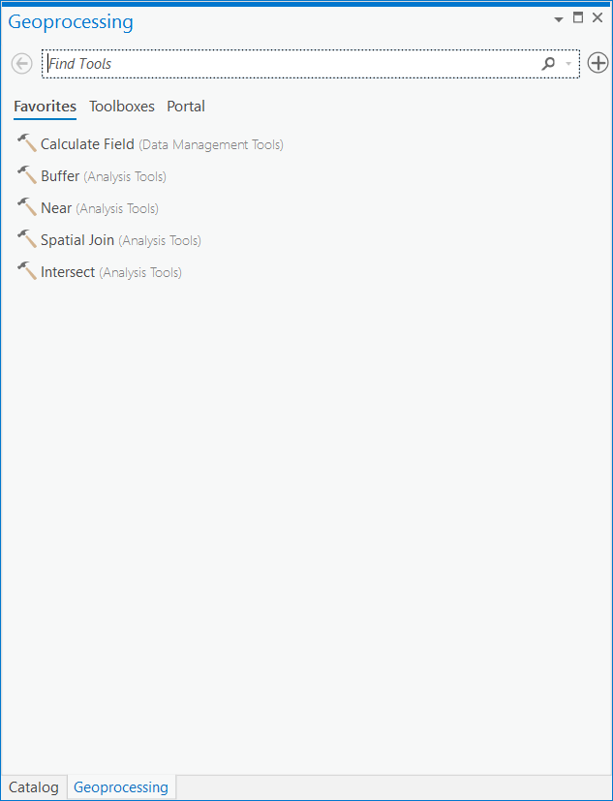
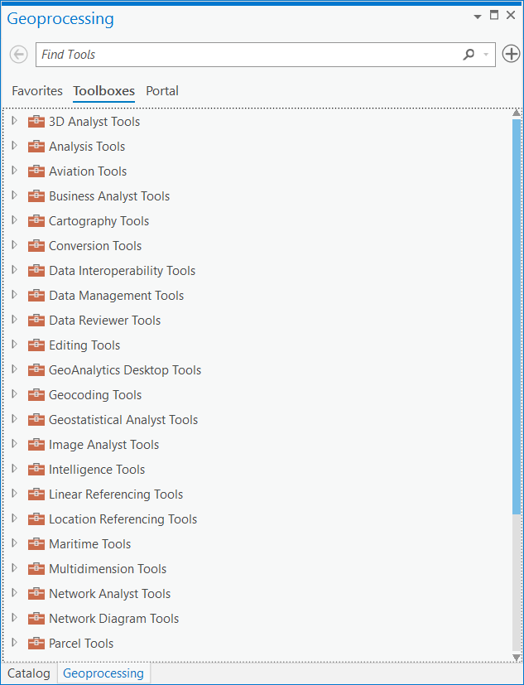
Toolboxes and Tools

Slide 5
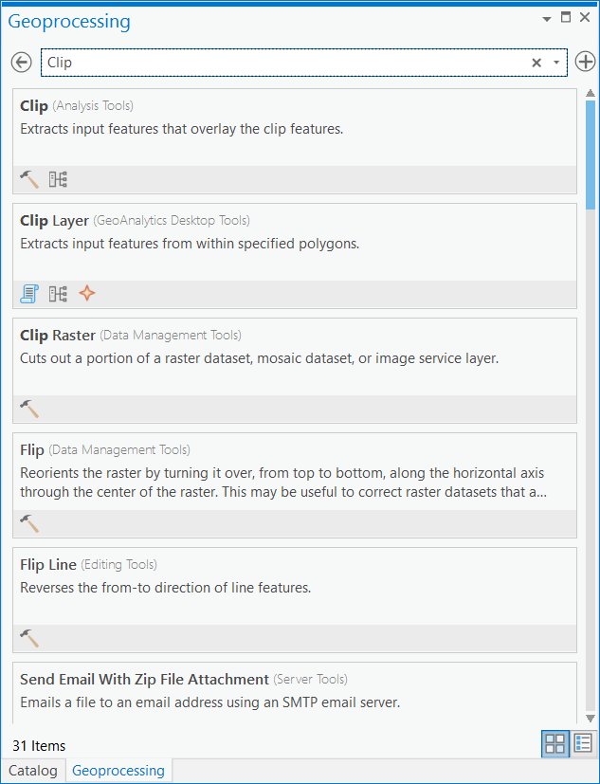
Toolboxes and Tools
Search – Still the easiest way to find the tool you want.

Slide 6
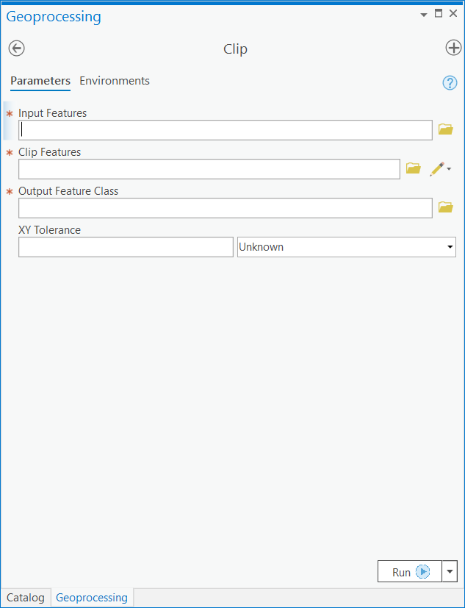
Example - Clip

Slide 7
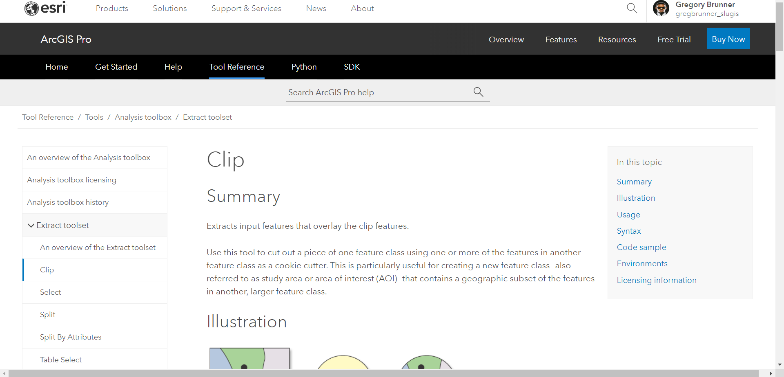
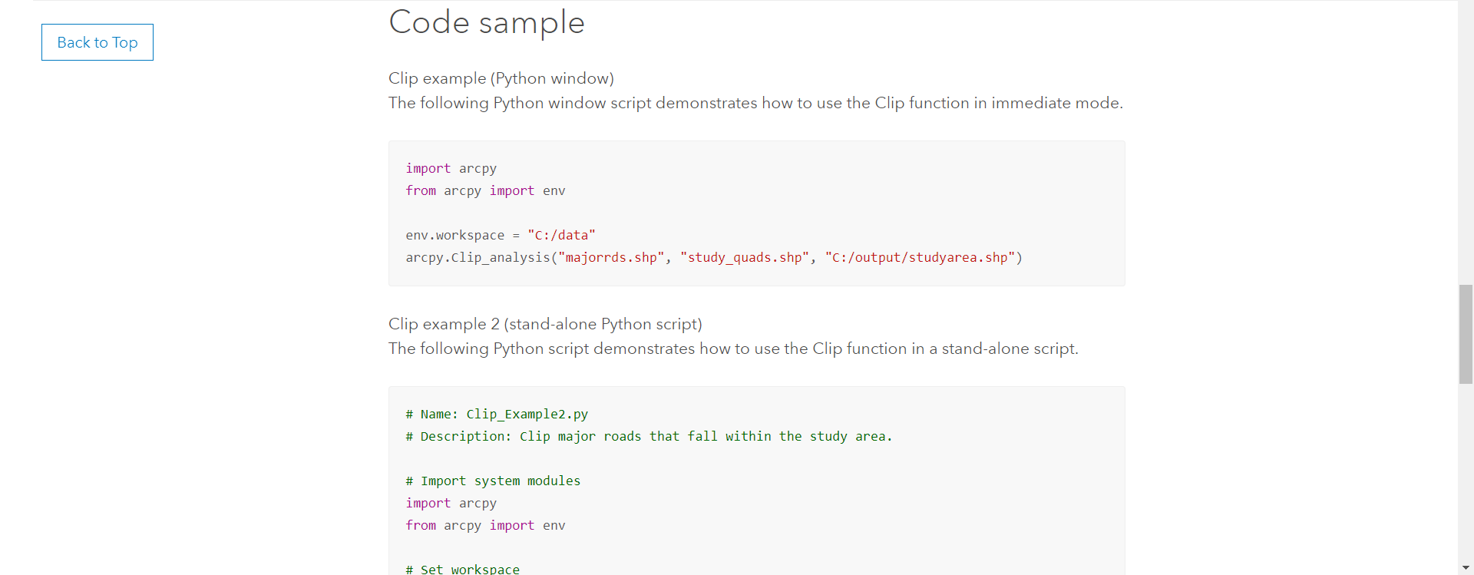
Tool Help
Notice the Python snippets at the bottom

Slide 8
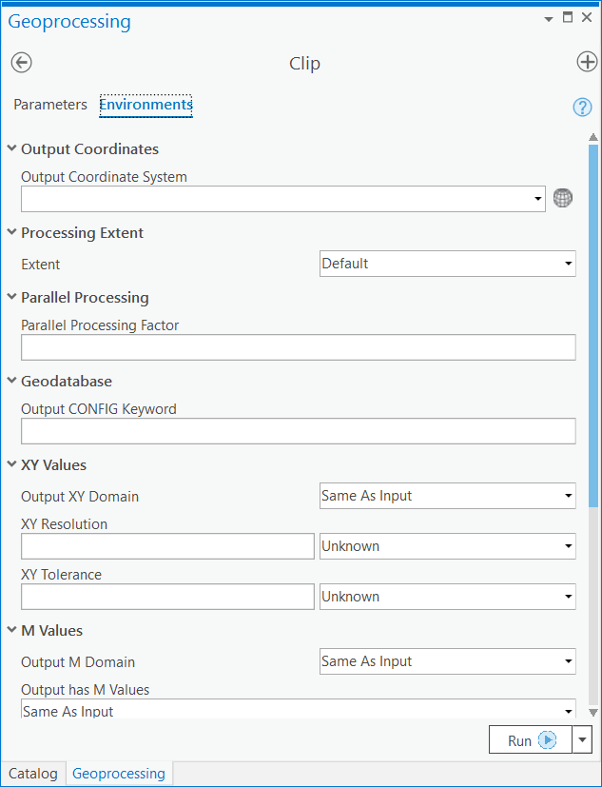
Environment Settings

Slide 9
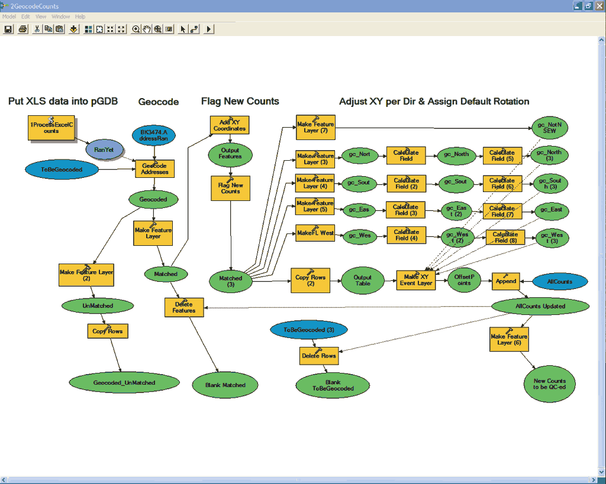
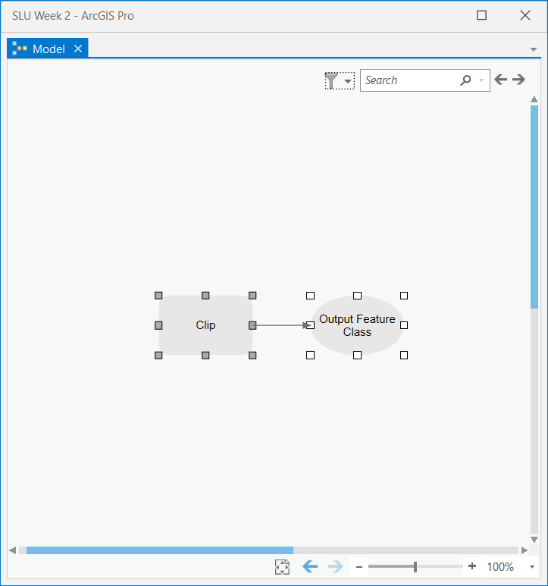
Models and ModelBuilder
In ArcMap
In ArcGIS Pro

Slide 10

Scripts as Tools

Slide 11
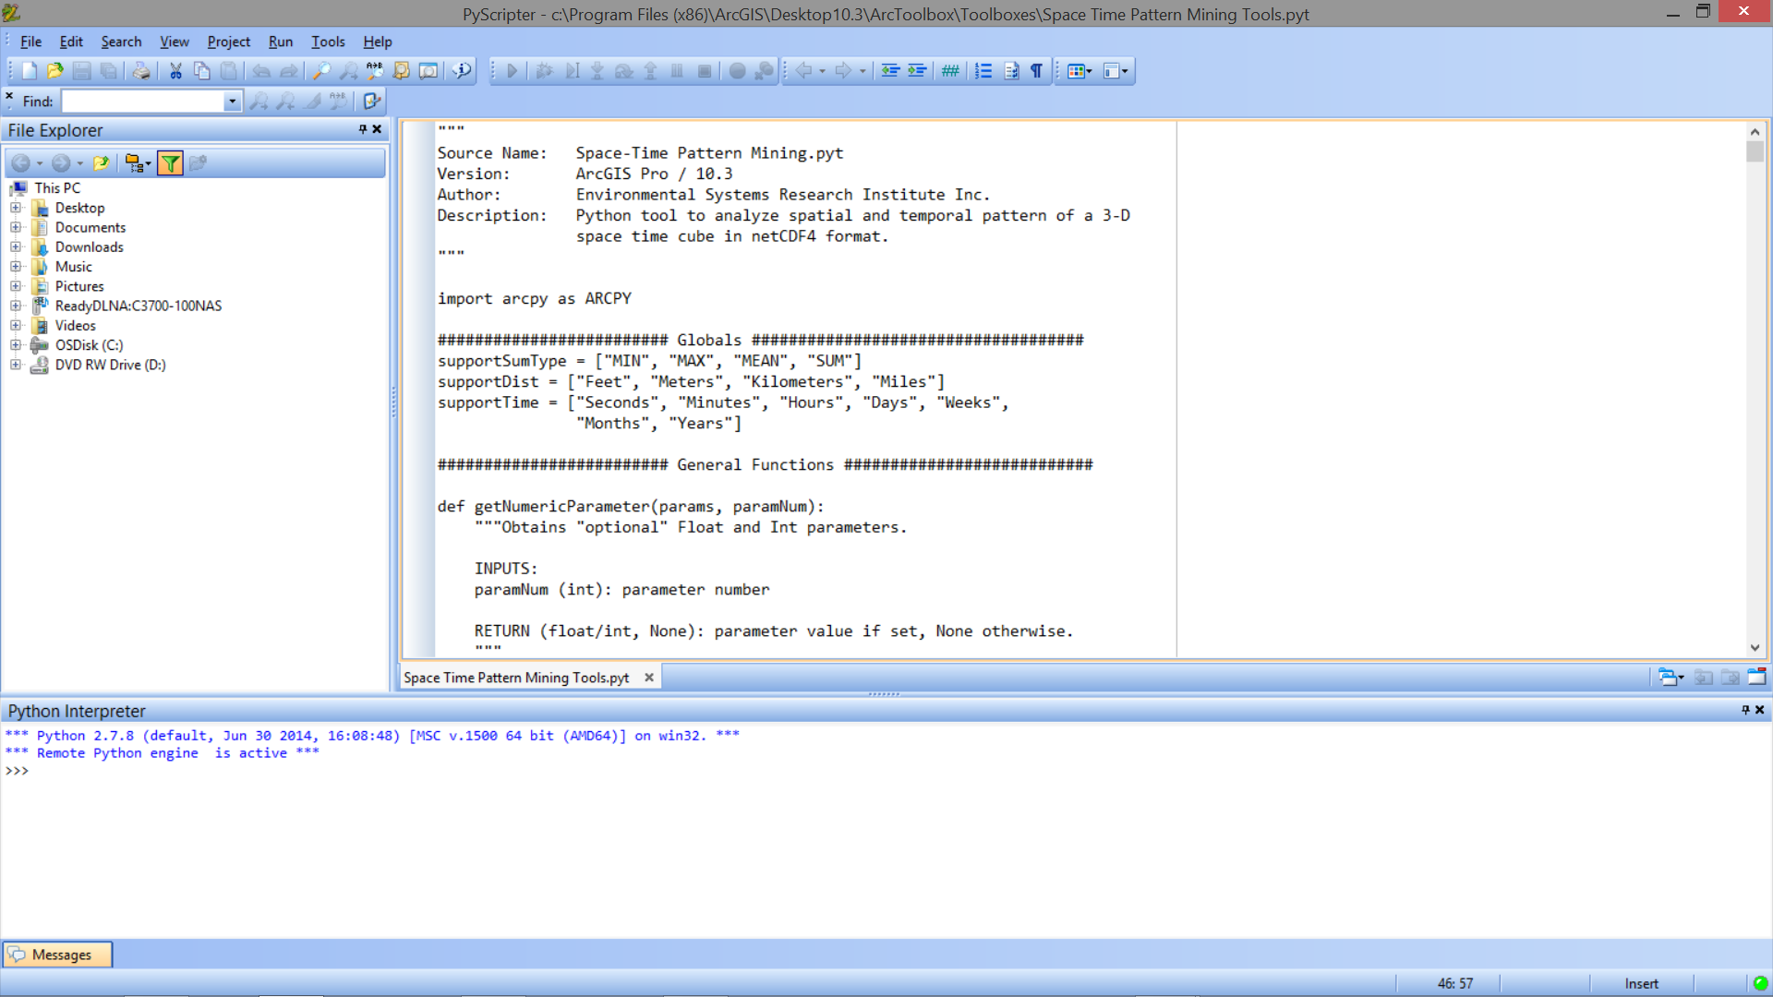
Scripts as Tools

Slide 12
The Python Window

Slide 13
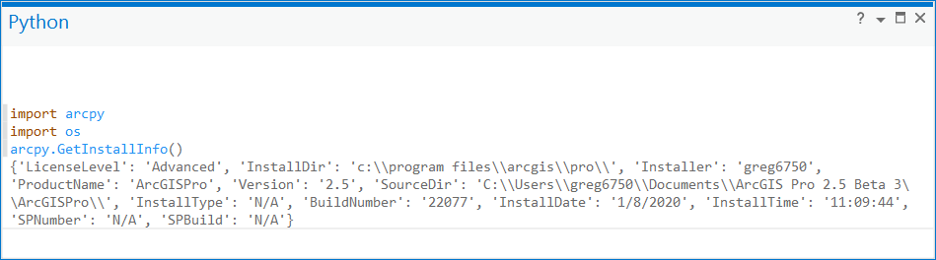
Python Window in ArcGIS Pro

Slide 14
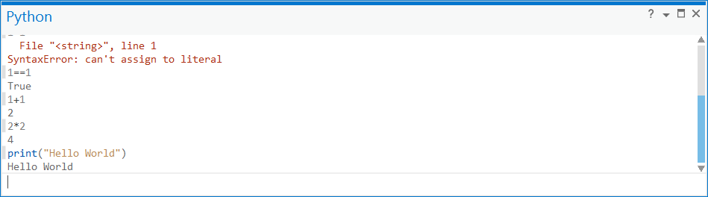
Writing Code
A place for writing Python code in ArcMap
GP tools accessible through Python Window
Code completion in Python Window!
Any standard modules should be accessible

Slide 15
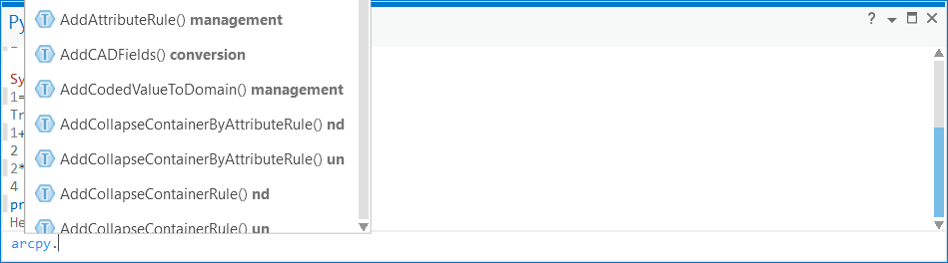
Getting Help
Code completion

Slide 16
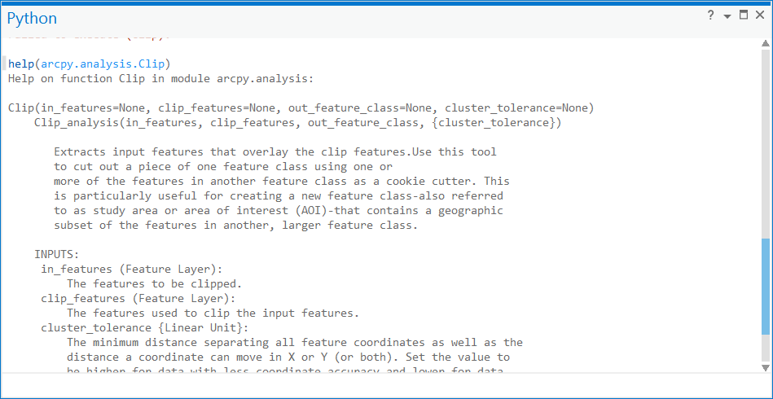
Getting Assistance

Slide 17
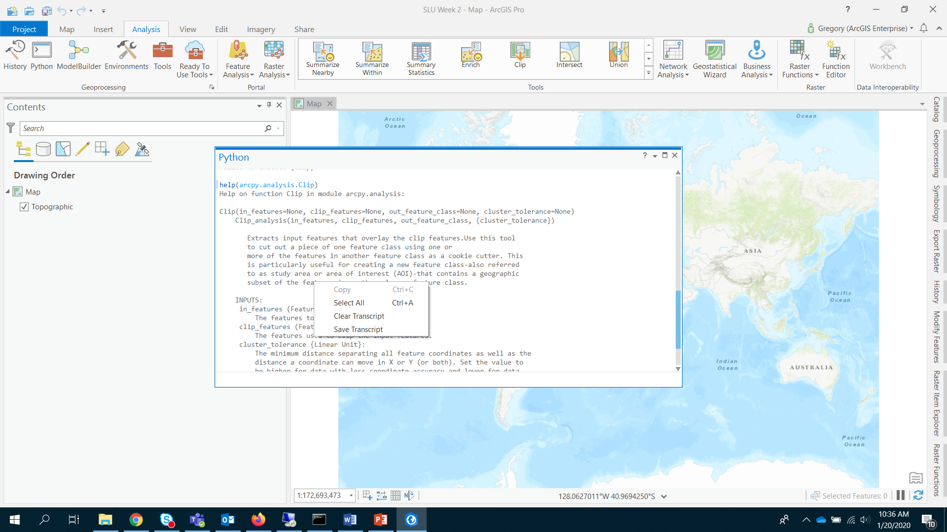
Saving Your Session

Slide 18
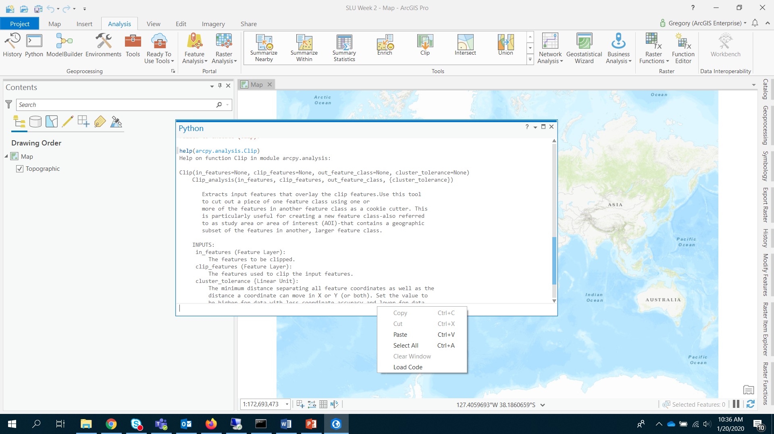
Loading Code
You can also load and run scripts through the Python Window

Slide 19
Let’s Launch Into the Python Window!

